Slide 1

INHERITANCE
CHAPTER6

Slide 2
Inheritance
Inheritance is a process in which one object acquires all the properties and behaviours of its parent object automatically.
The class which inherits the members of another class is called derived class.
the class whose members are inherited is called base class.
The derived class is the specialized class for the base class.

Slide 3
Advantages
Code reusability:
Now you can reuse the members of your parent class. So, there is no need to define the member again.
So, less code is required in the class

Slide 4
ACCESS SPECIFIER
Access specifiers define how the members (attributes and methods) of a class can be accessed.
There are three access specifiers:
Public: When the member is declared as public, it is accessible to all the functions of the program.
Private: When the member is declared as private, it is accessible within the class only.
Protected: When the member is declared as protected, it is accessible within its own class as well as the class immediately derived from it.

Slide 5
Types Of Inheritance
Five types of inheritance:
Single inheritance
Multiple inheritance
Hierarchical inheritance
Multilevel inheritance
Hybrid inheritance

Slide 6
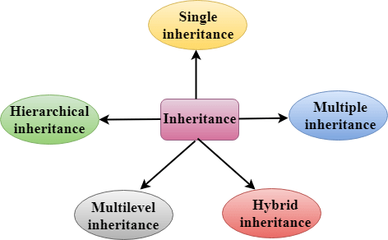
DIAGRAM

Slide 7
Derived Classes .
A Derived class is defined as the class derived from the base class.
Syntax
class derived_class_name:: visibility mode base_class_name
{
// body of the derived class.
}

Slide 8

SINGLE INHERITANCE
Single inheritance is defined as the inheritance in which a derived class is inherited from the only one base class.
Where 'A' is the base class, and 'B' is the derived class.
.

Slide 9

Multilevel Inheritance
Multilevel inheritance is a process of deriving a class from another derived class.

Slide 10
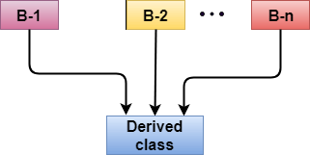
Multiple inheritance
Multiple inheritance is the process of deriving a new class that inherits the attributes from two or more classes.

Slide 11
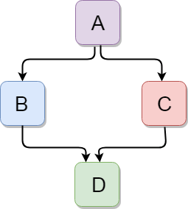
Hybrid Inheritance
Hybrid inheritance is a combination of more than one type of inheritance.

Slide 12
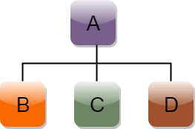
Hierarchical Inheritance
Hierarchical inheritance is defined as the process of deriving more than one class from a base class.

